Slide 1
Physical Computing
Raspberry Pi Pico and Micro-Python

Slide 2
Lesson 1 Starter Activity
A microcontroller is an integrated circuit. Microcontrollers have programmable input/outputs, built-in memory, and a processor.
They are small computers designed to perform a specific task in an embedded system.
Embedded systems are all around us they help make our everyday live easier and safer by performing repetitive or dangerous activities.
Notes:
This introduction should allow students to retrieve prior learning from earlier in ks3

Slide 3
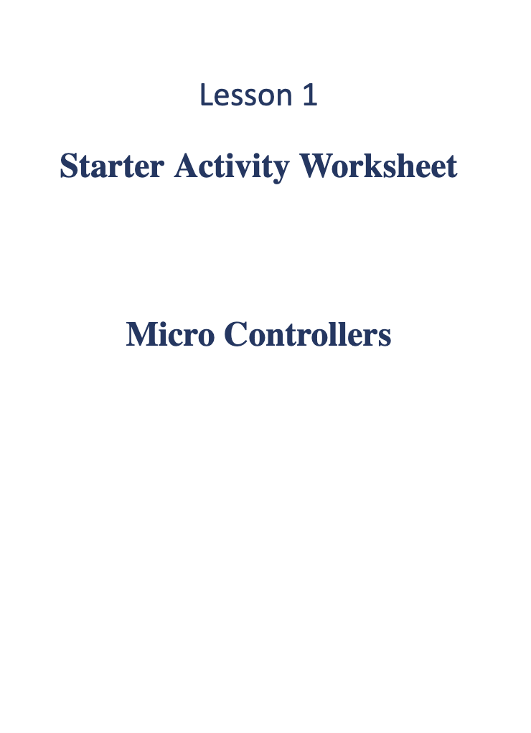
Smart Home Assistants
Alexa or Google home smart assistants are examples of embedded systems.
Complete the starter worksheet activity to identify the inputs and outputs of a smart home assistant.

Slide 4
In this unit you will learn
About the the Raspberry Pi Pico Microcontroller
How to make use of its general purpose pins to expand its use
How control a range of components using Micropython to create simple systems

Slide 5
In this lesson you will learn
That a Raspberry Pi Pico is a microcontroller that has GPIO Pins that allow connections to external devices
How to connect, set up and communicate directly with the Pico using Thonny and Micro-python
How to create a sequence of instructions in Micro-Python to control a GPIO Pin on the Pico

Slide 6
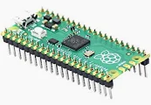
The Pico RP2040 Microcontroller
Definition: A microcontroller is a compact integrated circuit designed to govern a specific operation in an embedded system. It typically combines a processor, memory (RAM and flash), and peripherals on a single chip.
The PICO has 26 multipurpose GIO pins which allow us to attach peripheral devices
Using Micropython we can write programs to control peripheral devices attached to the PICO

Slide 7
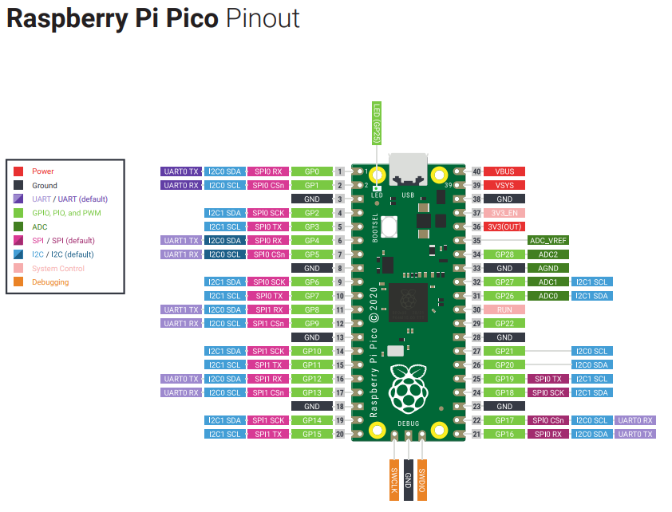
Pico RP2040 and it’s Pins
Different pins have different uses the Pico has 40 Pins
26 are GPIO
Notes:
Image of the RP2040 Pico and its Pin, point out the boot select button top left hand side for installing firmware and the USB port at the top for connecting to the computer for programming. You should also point out the the Pins physical numbers are not the same as the GPIO numbers and that the GPIO numbers are need fro programming. The different pins can be used fro different protocols Students will learn about two of the different protols later in the unit.
The LED is attached to a PIN 25 ******** note on a PICO W the led is no longer on PIN 25 but is attached directly to the CHIP and is referred to as “LED” in micro python see sample file
Draw student’s attention to the fact that the physical pin numbers do not correlate to the GPIO numbers and explain that this is because some physical PINs have other purposes such as voltage and ground etc to create circuits explain that Inputs and outs need voltage – power as well as instructions in order to work
The handout outline the protocols available for each Pin, you may want to adapt how much information you provide at this point. But today we will use the pins as digital output pins

Slide 8

Activity
Examine the code snippet on the worksheet
Predict what will happen when the code is executed
Record your ideas on the worksheet
Notes:
Students should be able to pull out aspects of the code such as libraries and iteration as well as identifying that the led will blink

Slide 9
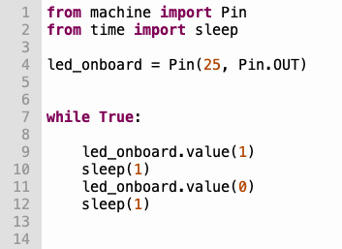
Let's examine examine the code
Annotate your worksheet to help you later
Import the pin module from the machine library
Import the sleep function from the time library
Initialise a digital pin object and assign it to Pin 25 set this as an output pin
While true creates an indefinite loop
.value() is method it sets the value of the pin to 0 or 1
1 = voltage on
0 = voltage off
Sleep() function is called to create a time delay
Notes:
Teacher run the code and allow students to view the output to LED. Break down the code with the students asking what would happen if questions example what would happen if we removed the sleep? What about if we increased the sleep. These questions can also be left for the students to work through later independently once the Pico is set up.

Slide 10
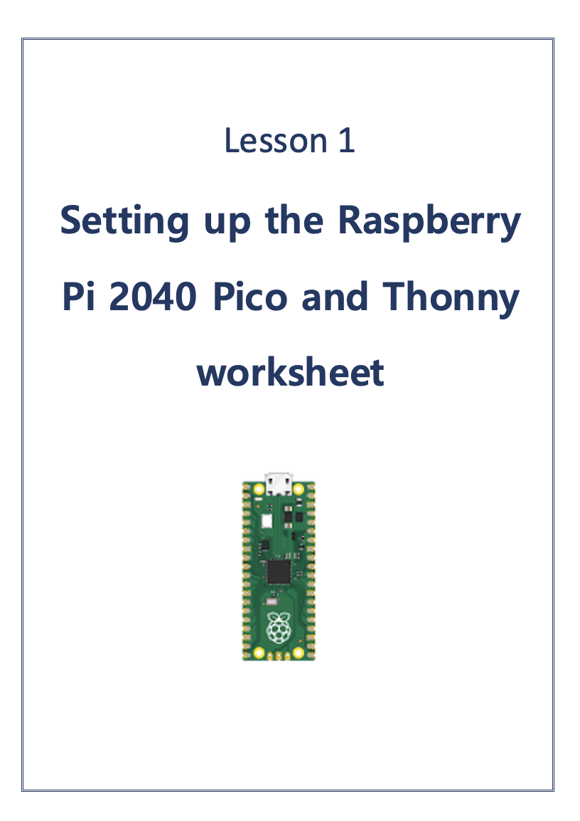
Activity Setting up the Pico & Thonny
You are going to use Thonny as your development environment
First you need to set up Thonny to communicate with the Pico
Notes:
Thonny allows us to interact directly with hardware directly via the serial port. It also has a great easy to read debugger. Demo the process of setting up the Pico in the Thony interpreter. The Pico must be connected for this process. The Pico and Thonny handout guides students through setting up Thonny for the pico should you wish to use this handout.

Slide 11
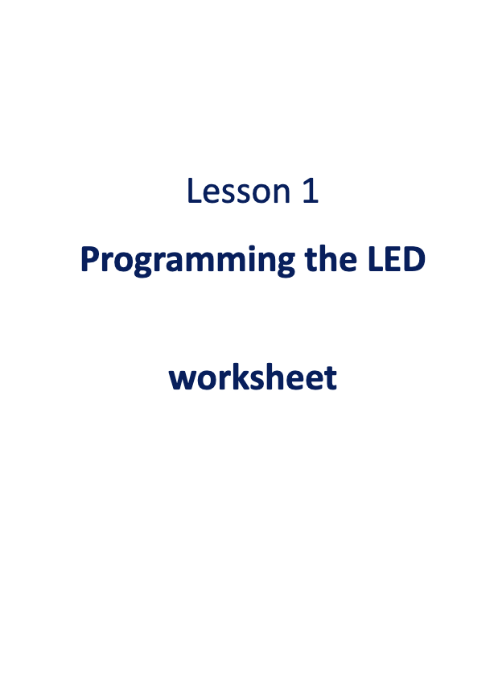
Activity 1 Programming the LED
You are going to use Thonny as your development environment
The worksheet setting up Raspberry Pi Pico will guide you through todays activities
Notes:
This final worksheet guides students through a range of activities. From blinking the LED, toggling the PIn and sleeping the pin to change the duration of the blnk. The final challenge involves students creating a message using morse code. Draw links to ASCII and Morse code how each uses only two symbols to represent text.

Slide 12
Quick recap quiz
Notes:
For this quick plenary to check understanding, you can have students record answers on post it notes, in class note books or on mini wipe boards.

Slide 13
GPIO stands for?
Notes:
General Pins input and output

Slide 14
How many GPIO pins does the Pico have?
Notes:
The Pico has 26 GPIO pens

Slide 15
How many states do digital pins have?
Notes:
Digital GPIO pins have two states 0 and 1

Slide 16

Homework
Read the information on the Introduction to the Pico worksheet and answer the questions at the bottom of the sheet
Notes:
Optional worksheet to allow students to find out more about the Pico. Teachers may wish to skip this and simply impart the information they feel is relevant to the students.
The Pico is powered by the RP2040 microcontroller, which was also designed by the Raspberry Pi Foundation. The RP2040 features a dual-core ARM Cortex-M0+ processor running at 133 MHz.
Memory: It has 264 KB of SRAM
GPIO (General Purpose Input/Output): The Pico has 26 GPIO pins, which can be used for various digital and analogue input/output tasks. This means devices such as motors, and sensors can be added to the Pico to create systems which can be used in day-to-day life such as alarm systems, robotics, heating and lighting control systems. It’s also great for creating small arcade style games.
Micro-USB Port: The Pico is powered and programmed via a micro-USB port.
Boot Options: The Pico can be used in two main ways - as a standalone microcontroller as part of an embedded system or as a USB peripheral device.

